Slide 1



Statistical Analysis and Learning (SAL): Unsupervised Learning, ISL Ch10 Textbook: An Introduction to Statistical Learning (ISL)
Varun Rai
LBJ School of Public Affairs
The University of Texas at Austin
25th April 2018

Slide 2
Note on Material
Unless otherwise noted, all material in this presentation are from this course’s textbook, An Introduction to Statistical Learning (ISL)

Slide 3
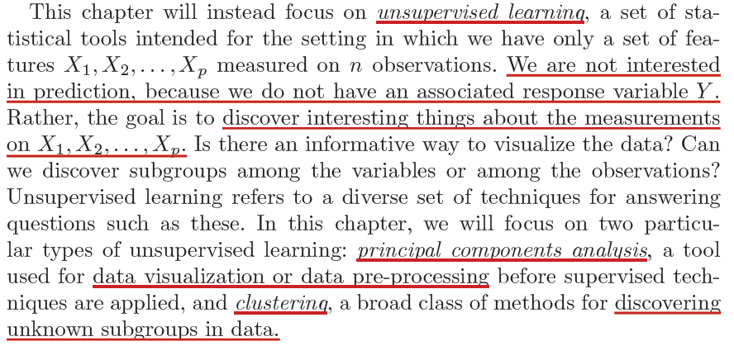
Unsupervised Learning

Slide 4
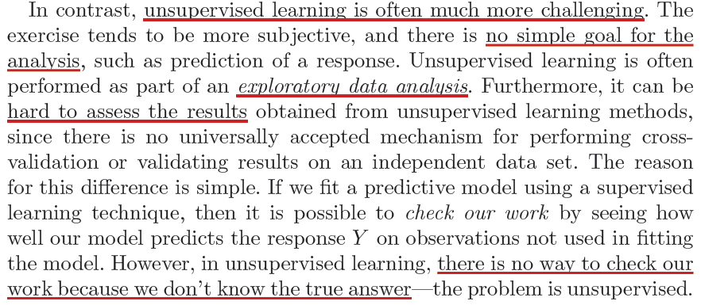
Challenges of Unsupervised Learning

Slide 5
Principal Component Analysis (PCA)

Slide 6
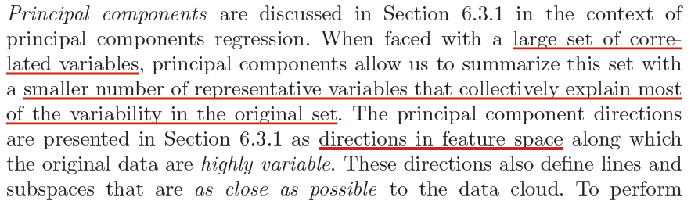
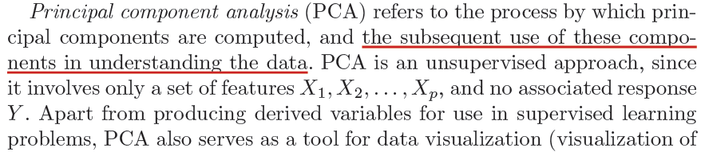
PCA

Slide 7
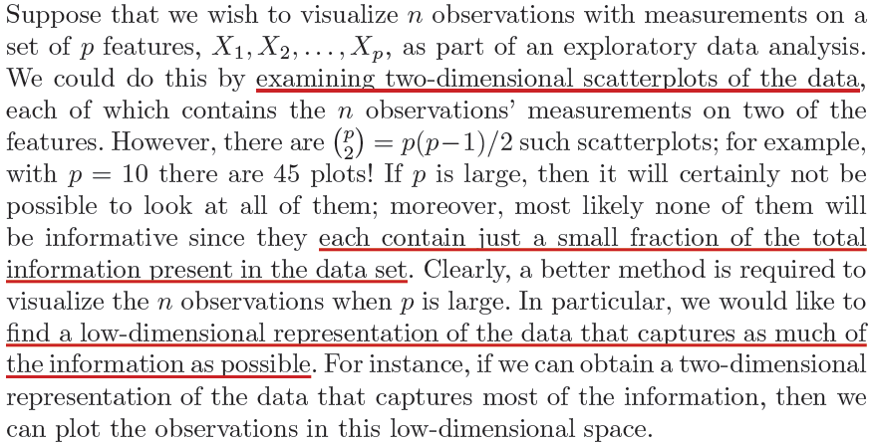
What are Principal Components?

Slide 8
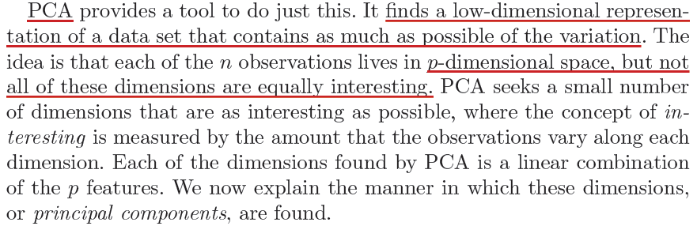
What are Principal Components?

Slide 9
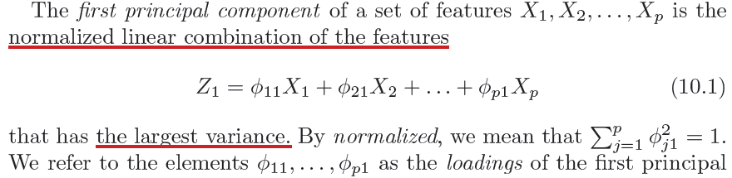
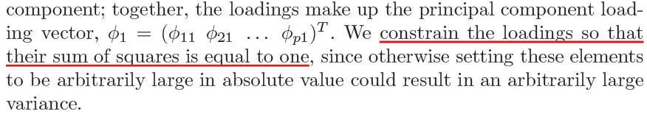
What are Principal Components?

Slide 10
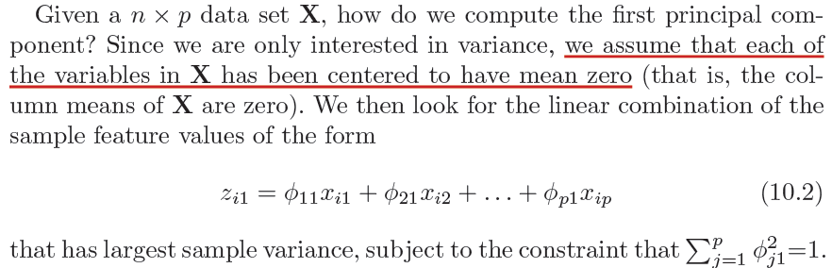
What are Principal Components?
loadings (first PC)
First principal component scores

Slide 11
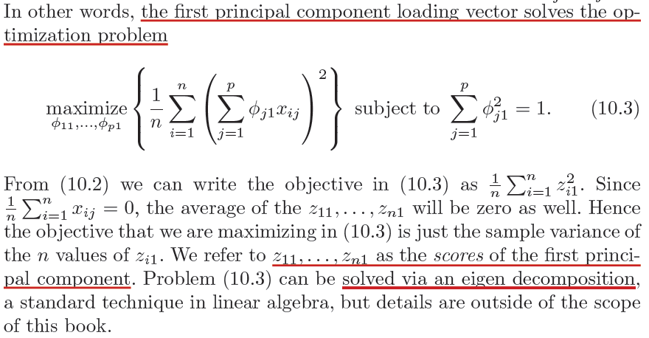
What are Principal Components?

Slide 12
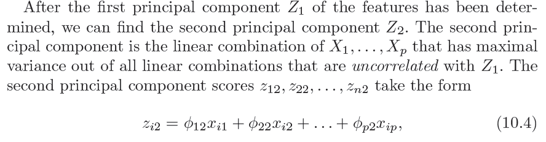
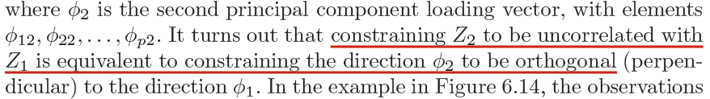
What are Principal Components?
loadings (second PC)
second principal component scores

Slide 13
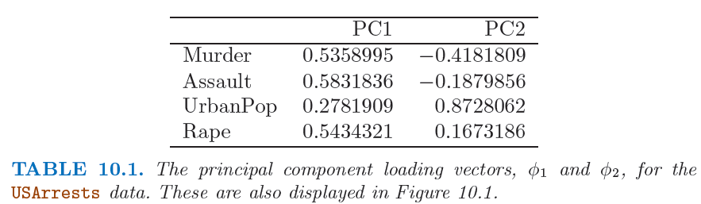
What are Principal Components?

Slide 14
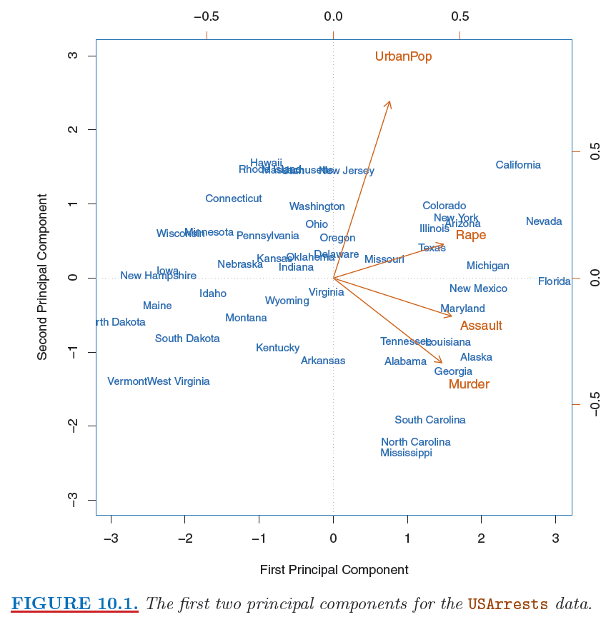
PCA: Biplot
Notes:
Orange arrows are the loadings for each predictor (top axis (first PC loading) and right axis (second PC loading)).

Slide 15
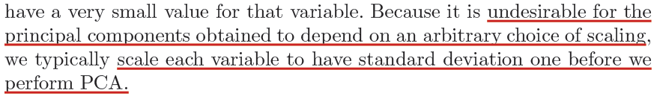
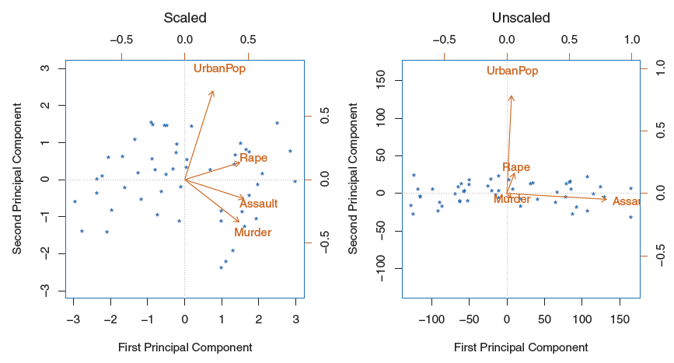
Scaling of Variables in PCA

Slide 16
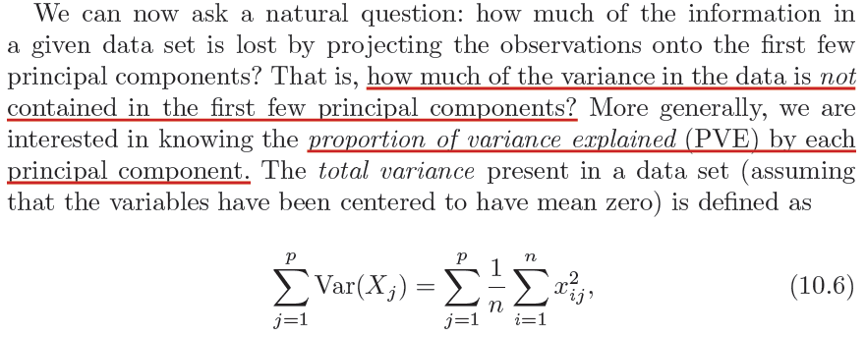
Proportion of Variation Explained (PVE)

Slide 17
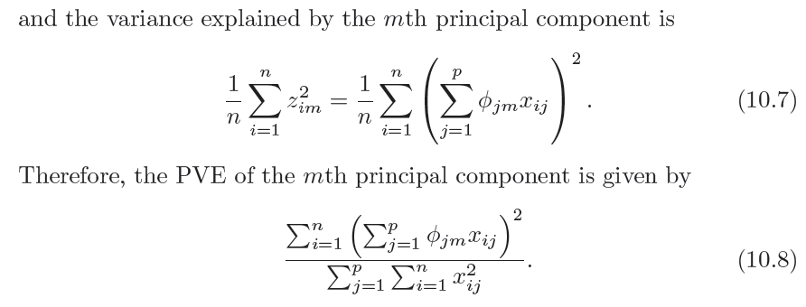
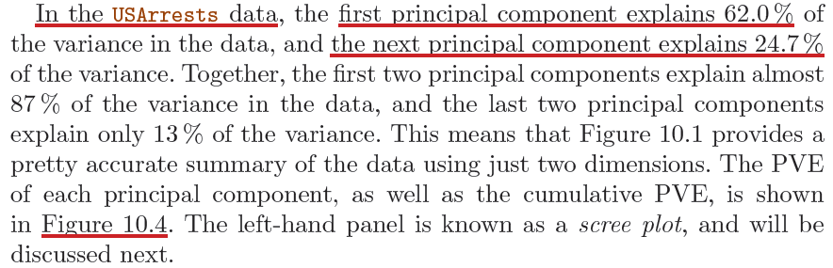
Proportion of Variation Explained (PVE)

Slide 18
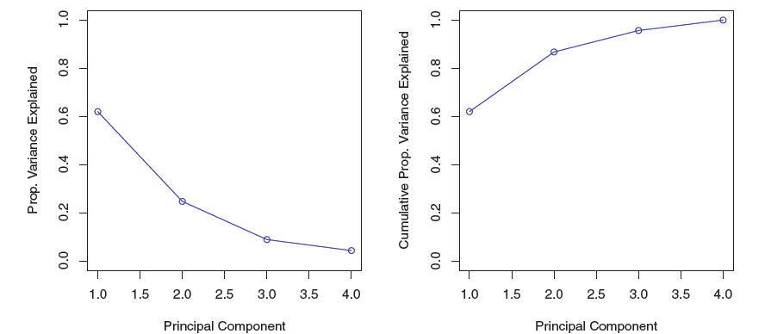
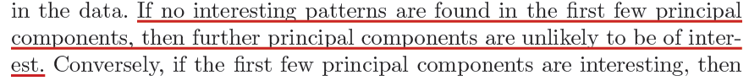
Scree Plot and Elbow

Slide 19
Clustering Methods

Slide 20
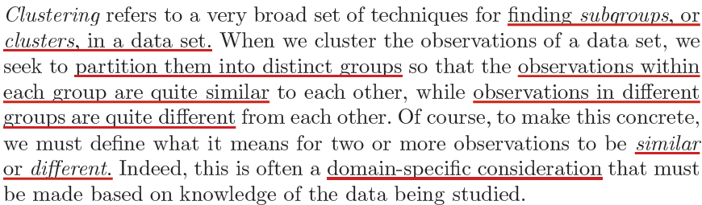
Clustering

Slide 21
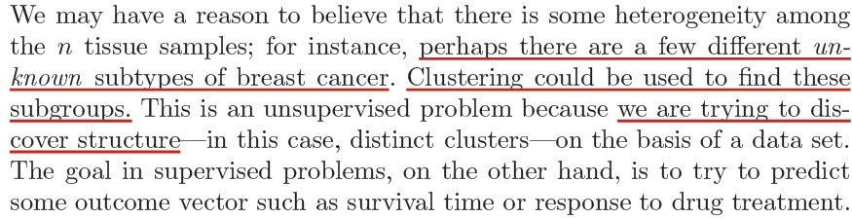
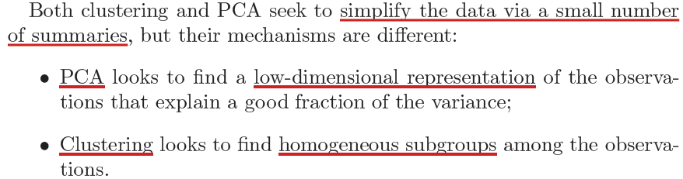
Clustering

Slide 22
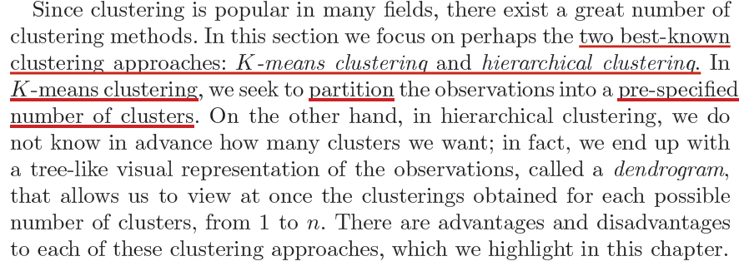
Clustering

Slide 23
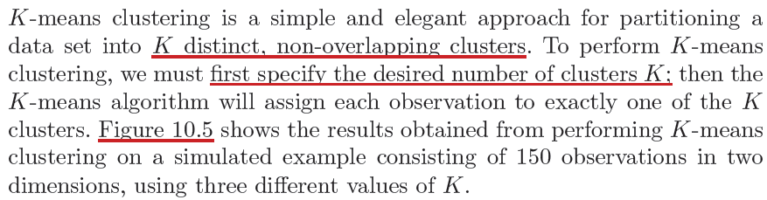
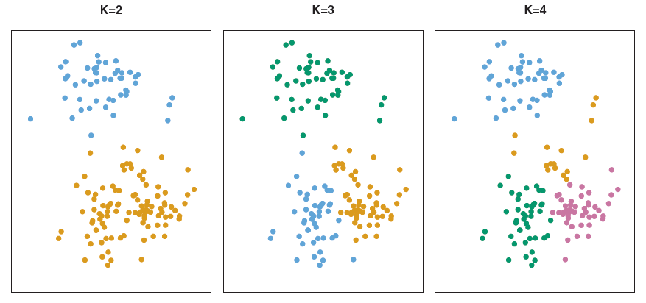
K-Means Clustering

Slide 24
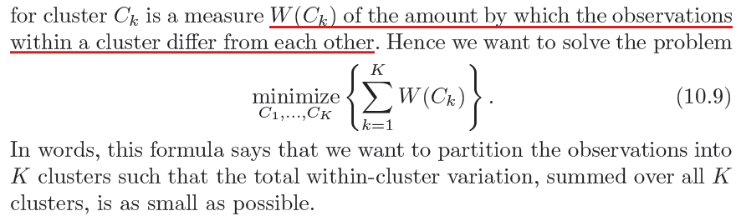
K-Means Clustering

Slide 25
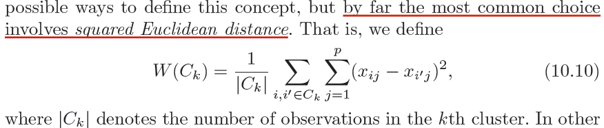
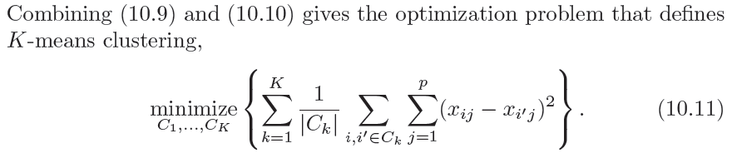
K-Means Clustering

Slide 26
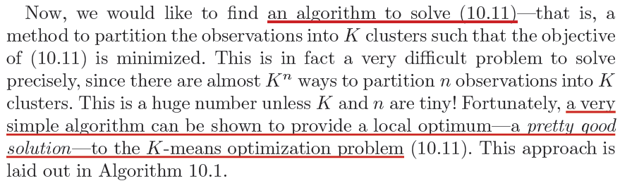
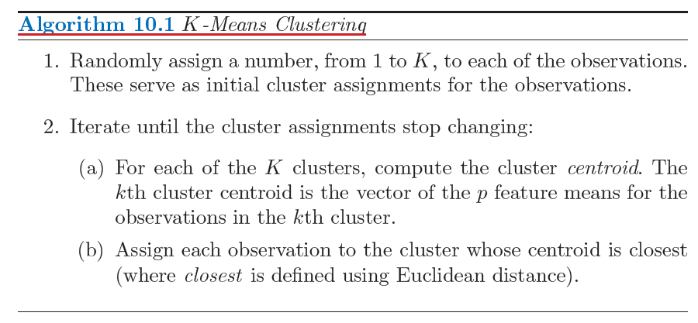
K-Means Clustering

Slide 27
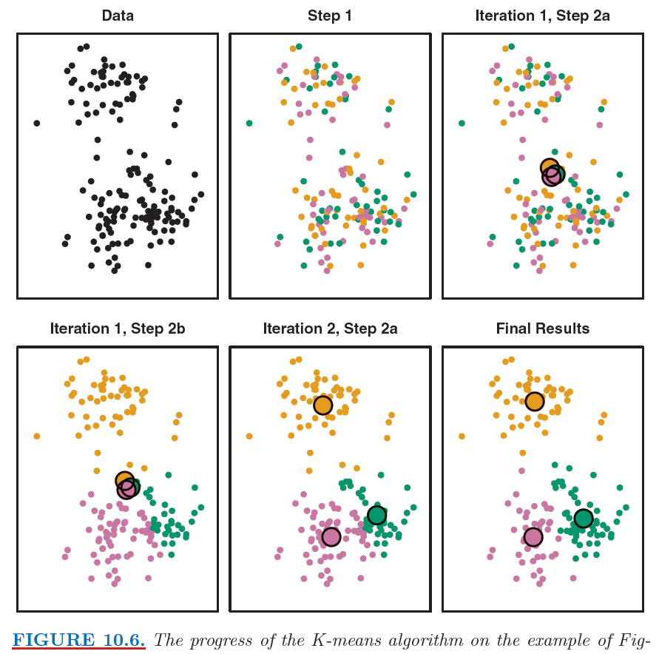

Slide 28
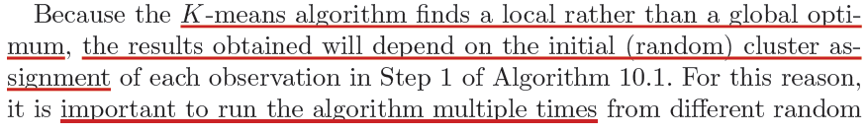
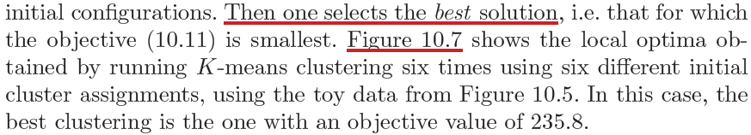
K-Means Clustering

Slide 29
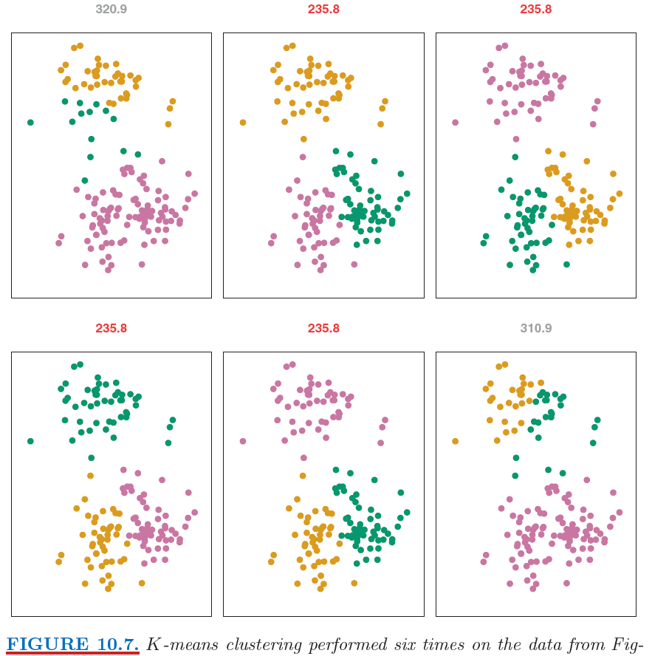
Notes:
End session 1

Slide 30
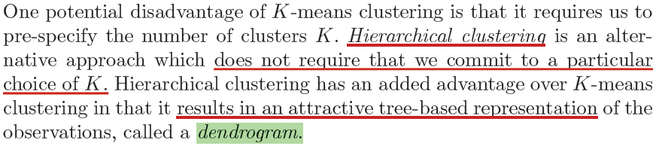
Hierarchical Clustering
Notes:
Begin session 2

Slide 31
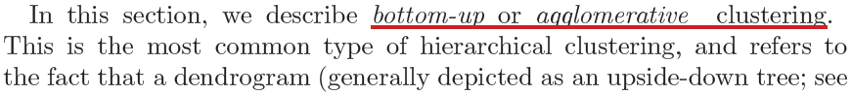
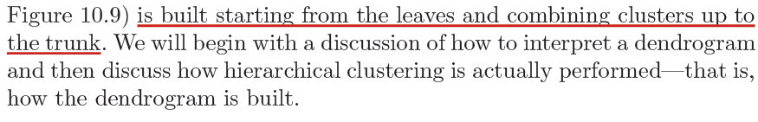
Hierarchical Clustering

Slide 32
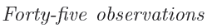
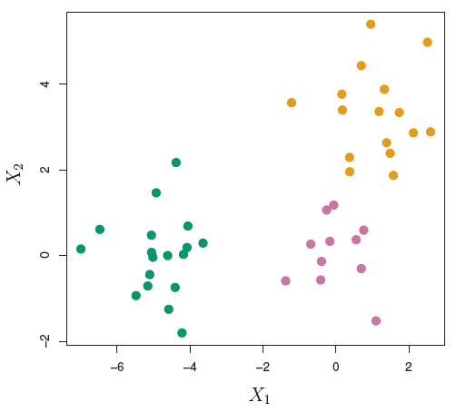
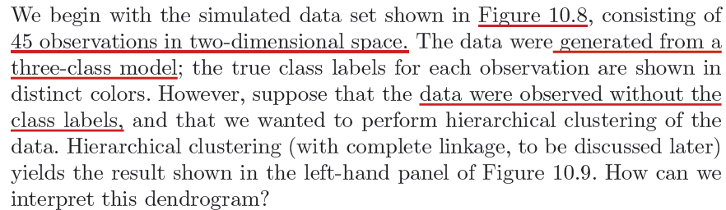
Hierarchical Clustering

Slide 33
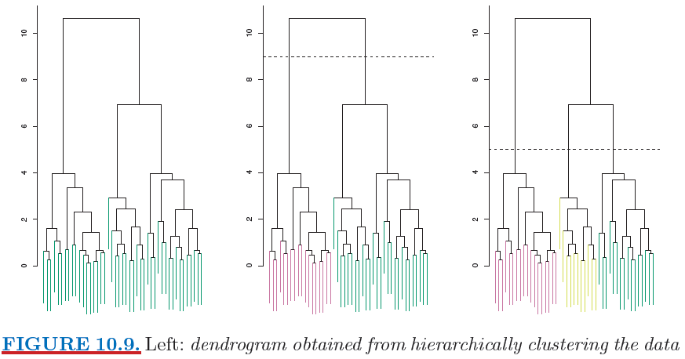
Dendrogram. Leafs, fusing into branches

Slide 34
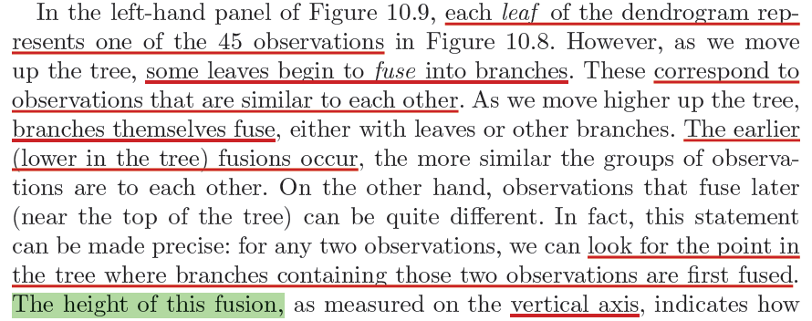
Dendrogram

Slide 35
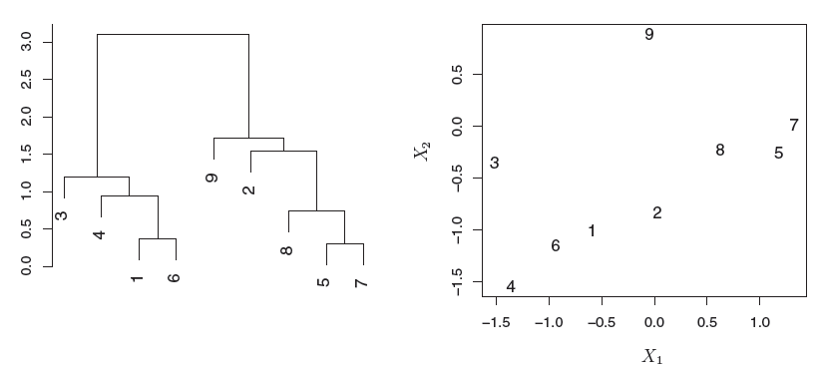
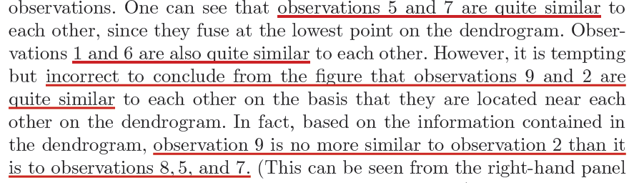
Interpreting a Dendrogram

Slide 36
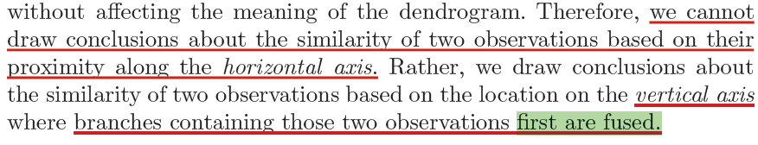
Interpreting a Dendrogram

Slide 37
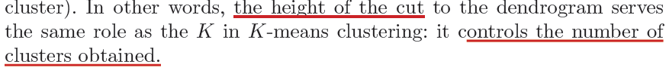
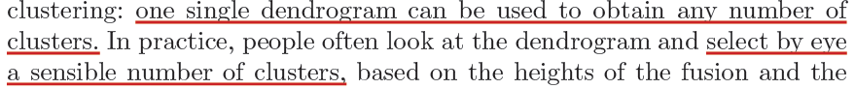
Getting Clusters from a Dendrogram...Cuts

Slide 38
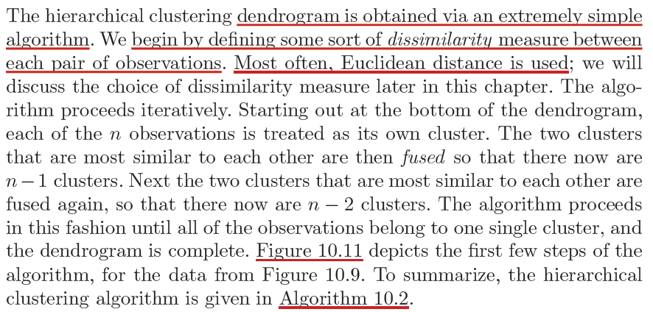
Algorithm for Hierarchical Clustering

Slide 39


Slide 40

Algorithm for Hierarchical Clustering

Slide 41

Linkage in Hierarchical Clustering

Slide 42

Algorithm for Hierarchical Clustering

Slide 43

Linkage in Hierarchical Clustering

Slide 44


Choice of Dissimilarity Measure

Slide 45

Choice of Dissimilarity Measure

Slide 46

Choice of Dissimilarity Measure

Slide 47

Choice of Dissimilarity Measure

Slide 48

Choice of Dissimilarity Measure, Scaling
Notes:
Left: raw number of purchase; Center: scaled by standard deviation; Right: scaled by dollar amount of purchase.

Slide 49

Validation

Slide 50

Notes:
End session 2

Slide 51

End of Lecture #14
Source: http://yaroslavvb.blogspot.com/

